Slide 1
Plan 8 NGO – NGO 6 days
NGO – Inuyama – Magome-juku – Narai-juku - Matsumoto – Okuhida Onsengo – Shirakawago – Takayama - Gujo Hachiman – Nagoya - NGO

Slide 2
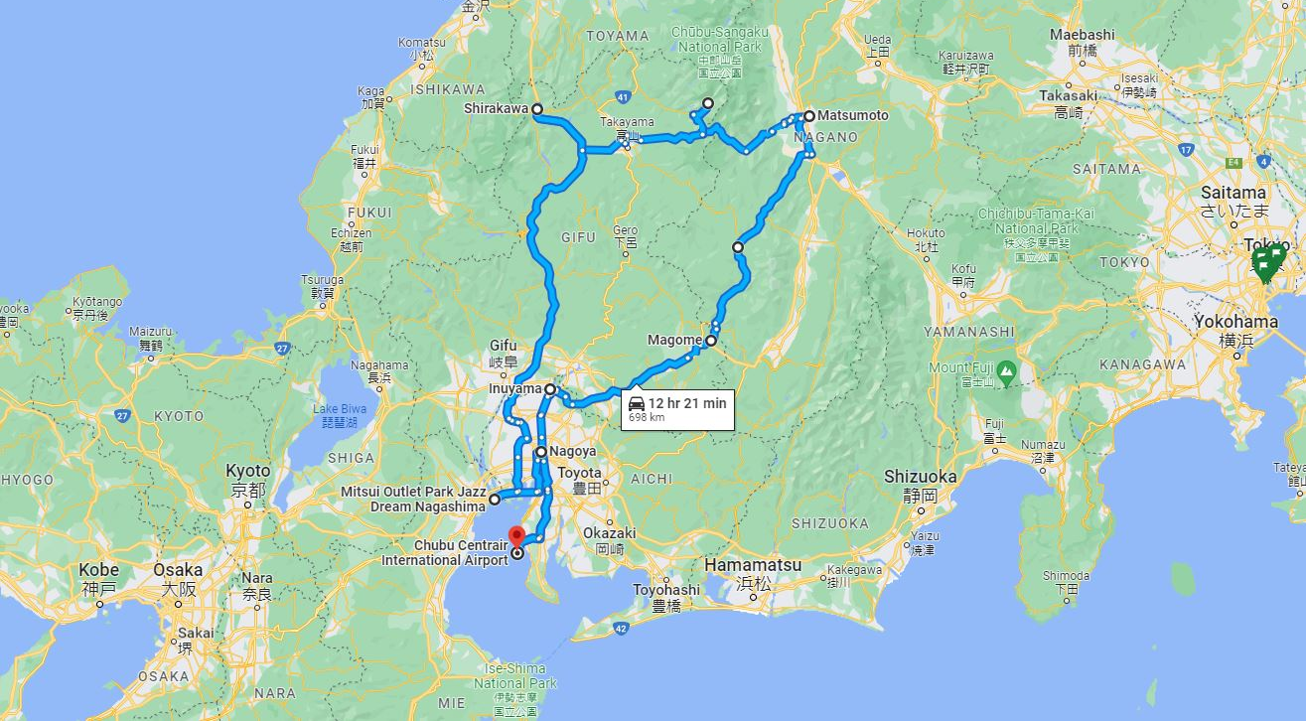

Slide 3
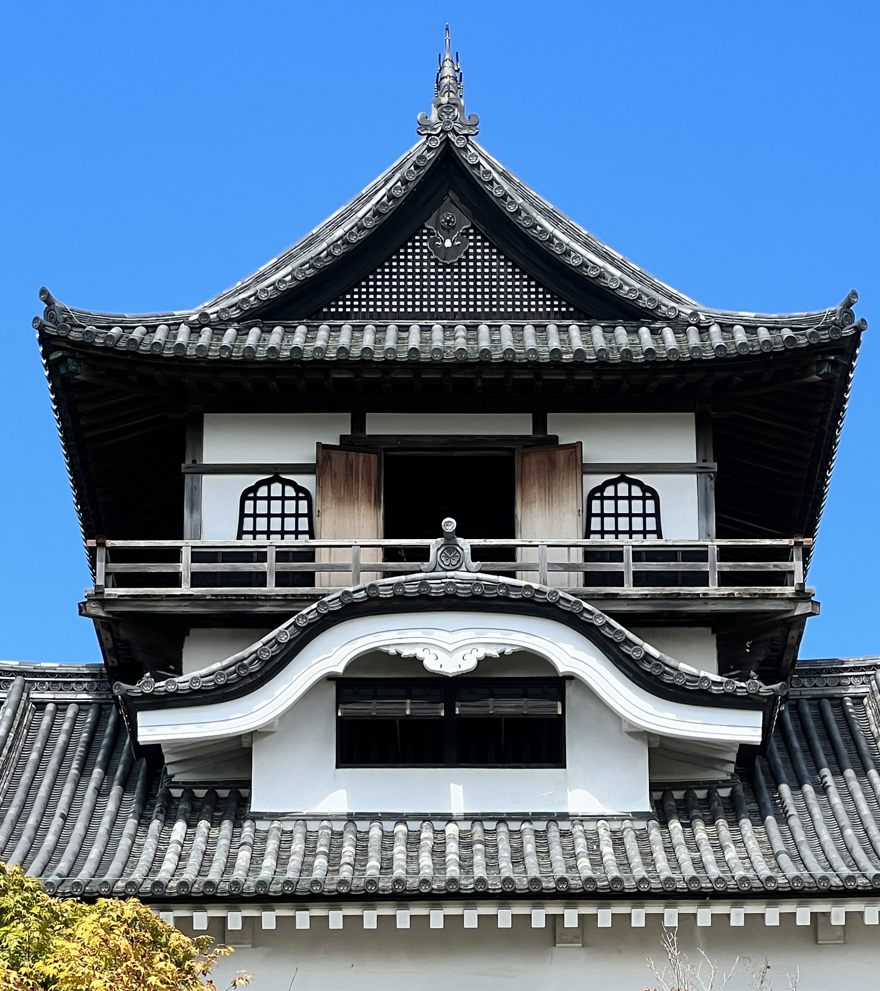

Slide 4
Plan 8 NGO – Inuyama – Magome-juku – Narai-juku- Matsumoto – Okuhida Onsengo – Shirakawago – Takayama – Gujo Hachiman – Nagoya – NGO
Day 1
NGO – (80 min.) – Inuyama
Day 2
Inuyama – (15 min.) – Inuyama Castle – (60 min.) –
Ena Gorge – (40 min.) – Magome-juku – (90 min.) –
Narai-juku – (70 min.) - Matsumoto
AM
Urakuen Japanese Garden
Inuyama Castle (National Treasure)
Ena Gorge
PM
Magome-juku
Narai-juku
Day 3
Matsumoto – (30 min.) – Daiso Wasabi Farm –
(110 min.) – Shin Hotaka Ropeway – (30 min.) –
Okuhida Bear Park – (10 min.) – Okuhida Onsengo
AM
Matsumoto Castle (National Treasure)
Yohashira Shrine and Nawate-dori Shopping Street
Lunch at Daio Wasabi Farm
PM
Shin Hotaka Ropeway
Okuhida Onsengo Hot Springs

Slide 5
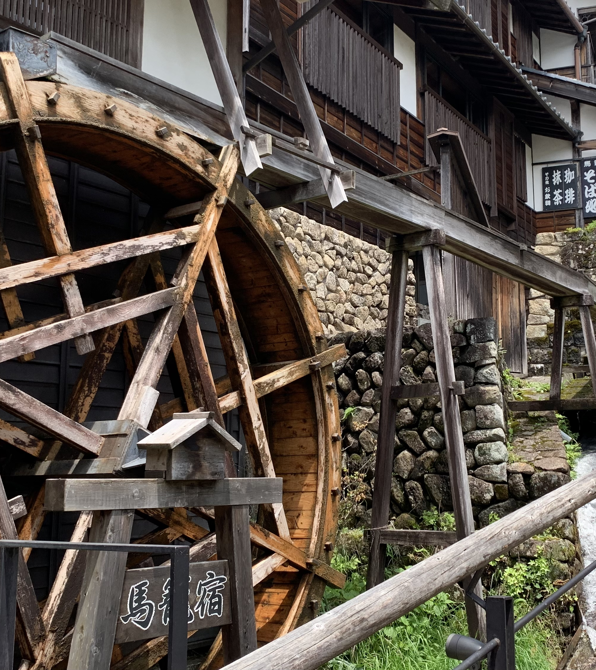

Slide 6
Plan 8 NGO – Inuyama – Magome-juku – Narai-juku- Matsumoto – Okuhida Onsengo – Shirakawago – Takayama – Gujo Hachiman – Nagoya – NGO
Day 4
Okuhida Onsengo - (90 min.) -Shirakawago –
(60 min.) - Takayama - (70 min.) - Gujo Hachiman
AM
Shirakawago
Takayama
PM
Gujo Hachiman Castle
Making Food Sample
Day 5
Gujo Hachiman - (90 min.) - Mitsui Outlet Park Jazz
Dream Nagashima - (40 min.) - Nagoya
AM
Mitsui Outlet Park Jazz Dream Nagashima
PM
Nagoya Castle
Kinshachi Yokocho Street

Slide 7
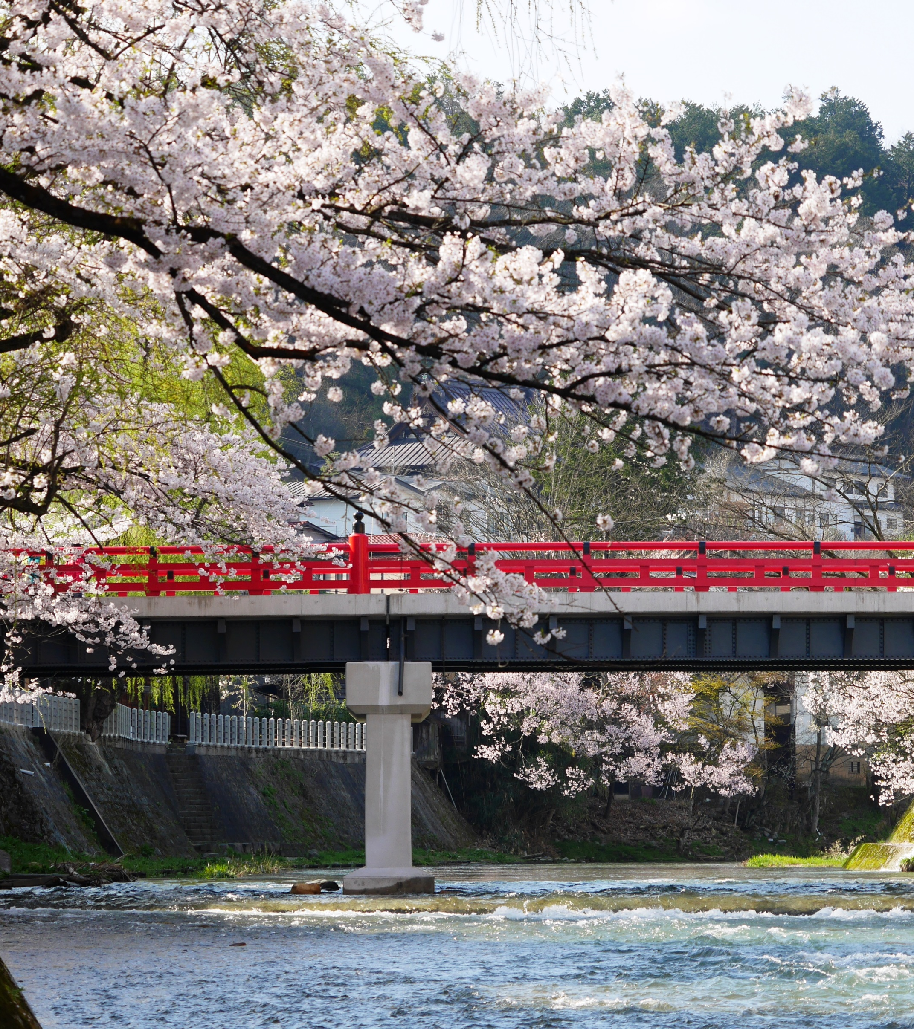

Slide 8
Plan 8 NGO – Inuyama – Magome-juku – Narai-juku- Matsumoto – Okuhida Onsengo
– Shirakawago – Takayama – Gujo Hachiman – Nagoya – NGO
Day 6
Nagoya - (40 min.) - NGO

