Slide 1
Plan 18 CTS – CTS 6 days ‘Sakura’in Southern Hokkaido
CTS – Noboribetsu – Yakumo – Onuma-koen – Goryokaku – Hakodate – Tobetsu – Matsumae – Mori – Lake Toya – Mt. Usu – Otaru – Sapporo – CTS

Slide 2
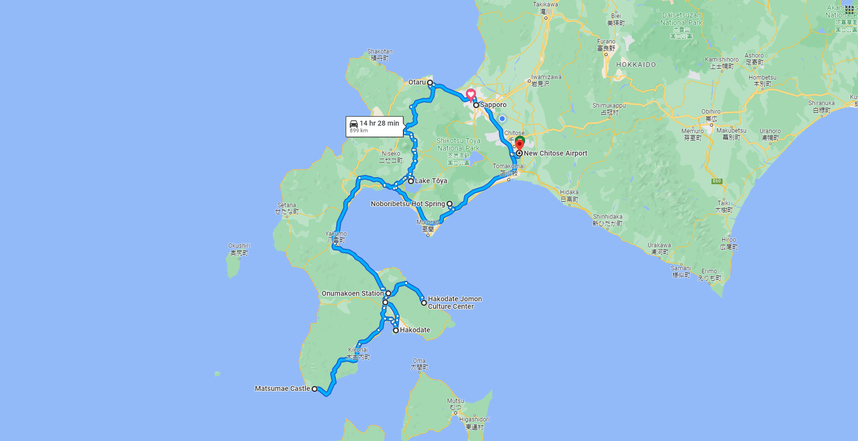
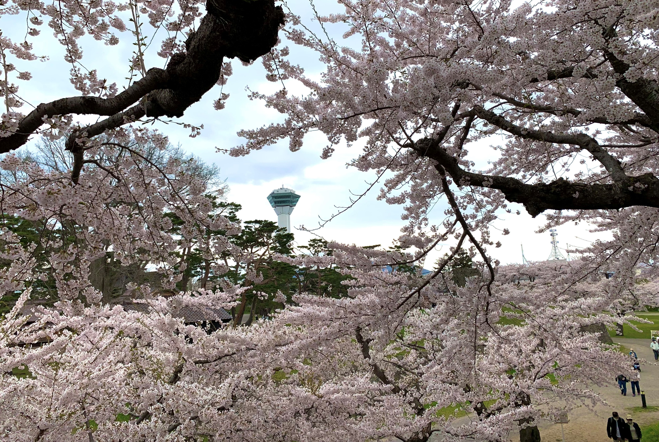
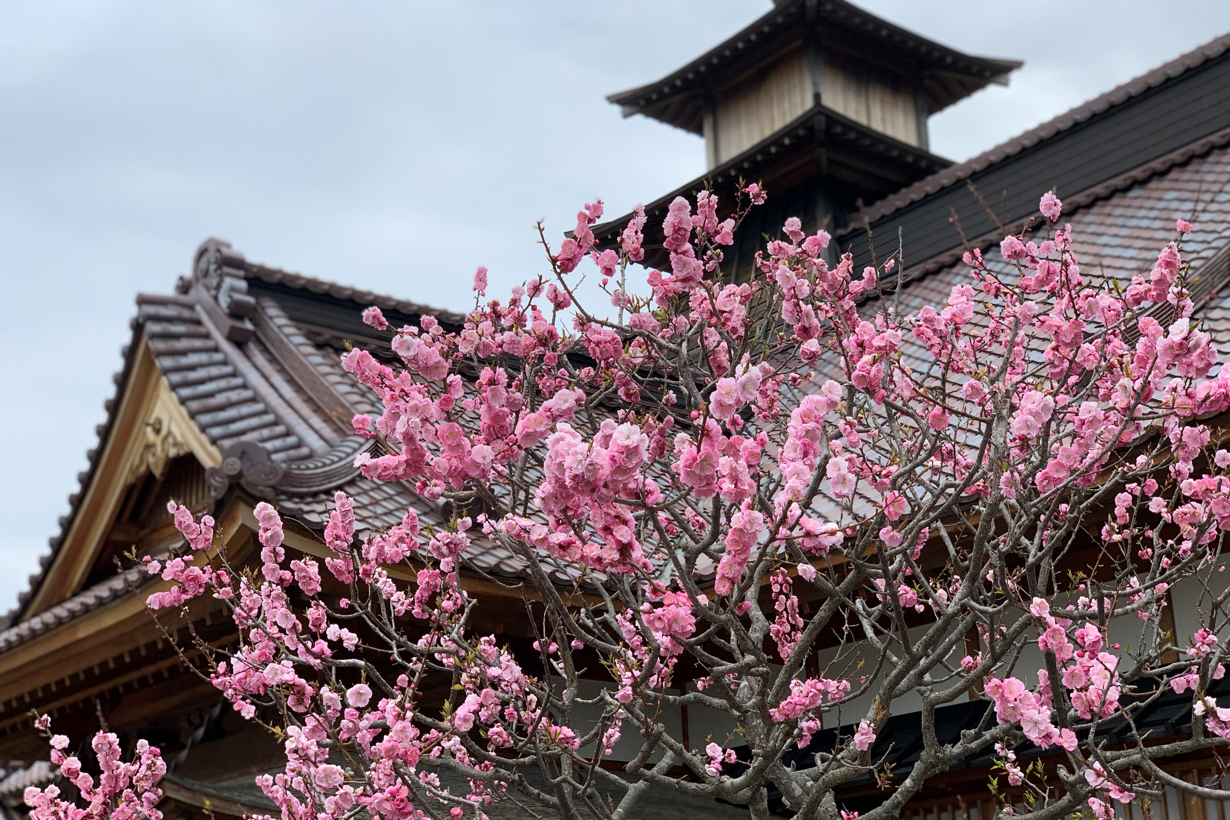
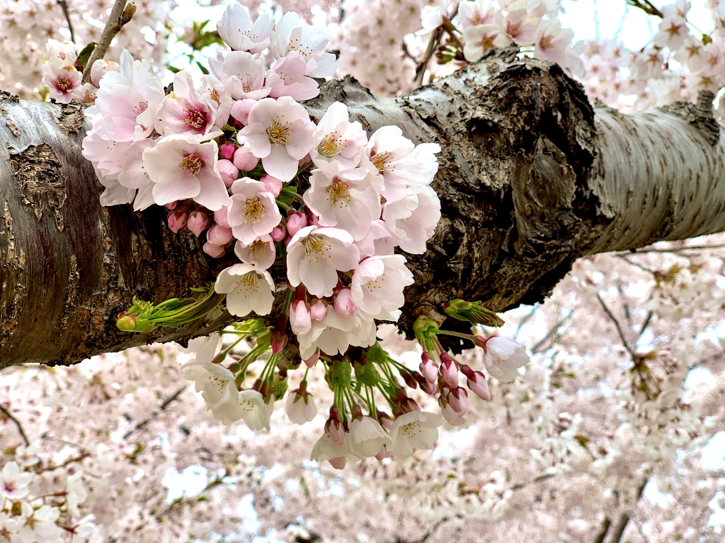
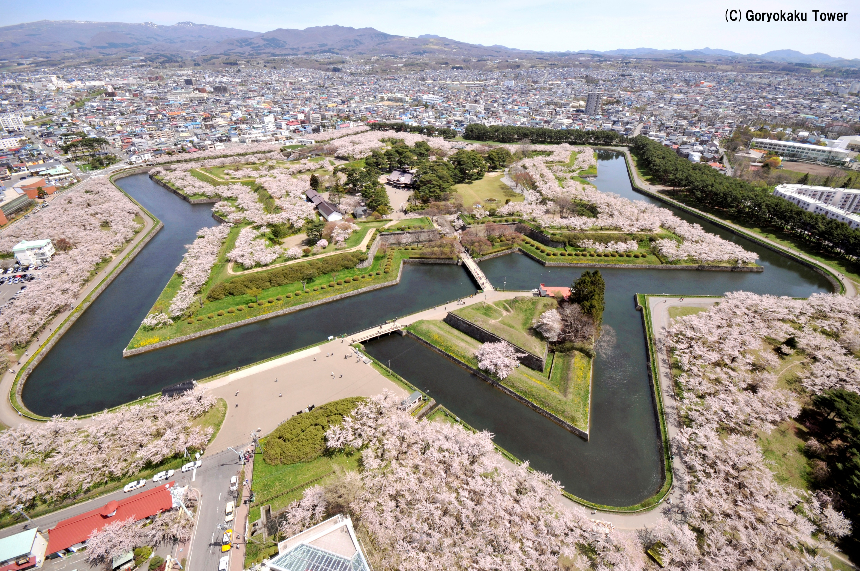

Slide 3
Plan 18 CTS – Noboribetsu – Yakumo – Onuma-koen – Goryokaku – Hakodate – Tobetsu – Matsumae – Mori – Lake Toya – Mt. Usu – Otaru – Sapporo – CTS
Day 1
CTS – (60 min.) – Noboribetsu – (110 min.) –
Yakumo – (50 min.) – Onuma-koen – (40 min.) –
Goryokaku – (20 min.) – Hakodate
AM
Noboribetsu Hell Velley
Harvester Yakumo
PM
Onuma Quasi National Park
Goryokaku Park
Day 2
Hakodate – (40 min.) – Tobetsu – (80 min.) –
Matsumae – (120 min.) – Hakodate
AM
Hakodate Asaichi Morning Market
Tobetsu Trapist Monastery
PM
Cherry blossoms at Matsumae Park
Mt. Hakodate Ropeway
Kanemori Red Brick Warehouse

Slide 4
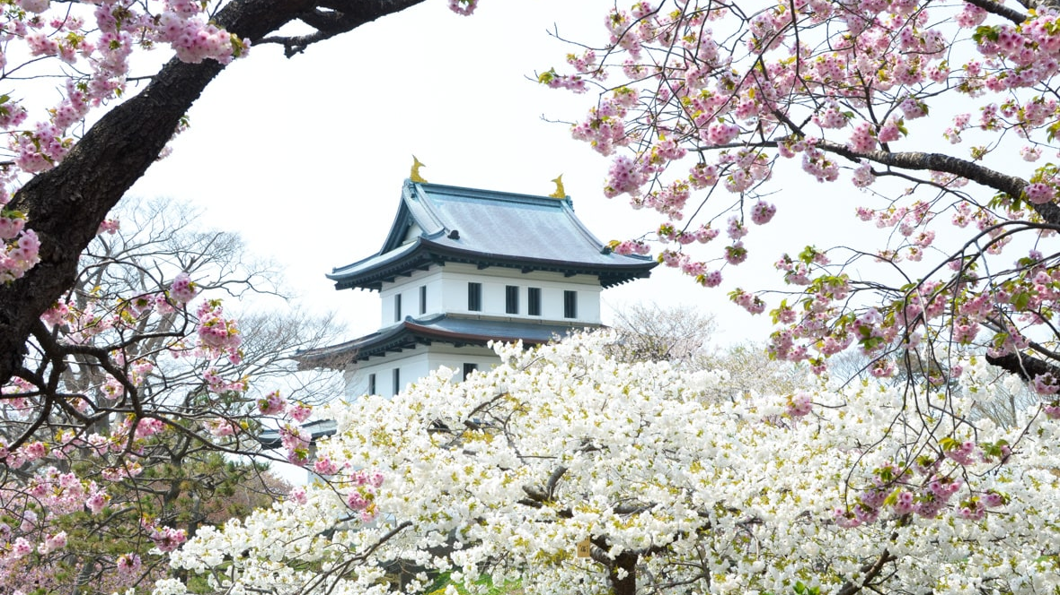

Slide 5
Plan 18 CTS – Noboribetsu – Yakumo – Onuma-koen – Goryokaku – Hakodate – Tobetsu – Matsumae – Mori – Lake Toya – Mt. Usu – Otaru – Sapporo – CTS
Day 3
Hakodate – (30 min.) – Trapistine Convent –
(50 min.) – Shikabe – (90 min.) – Mori –
(70 min.) – Lake Toya
AM
Trapistine Convent
Hakodate Jomon Culture Center
PM
Oniushi Park
Lake Toya
Day 4
Lake Toya – (20 min.) – Mt. Usu – (140 min.) –
Otaru – (60 min.) – Sapporo
AM
Mt. Usu Ropeway
PM
Otaru Canal
Kitaichi Glass Sangokan
Otaru Music Box Museum
Sakaimachi Shopping Street

Slide 6
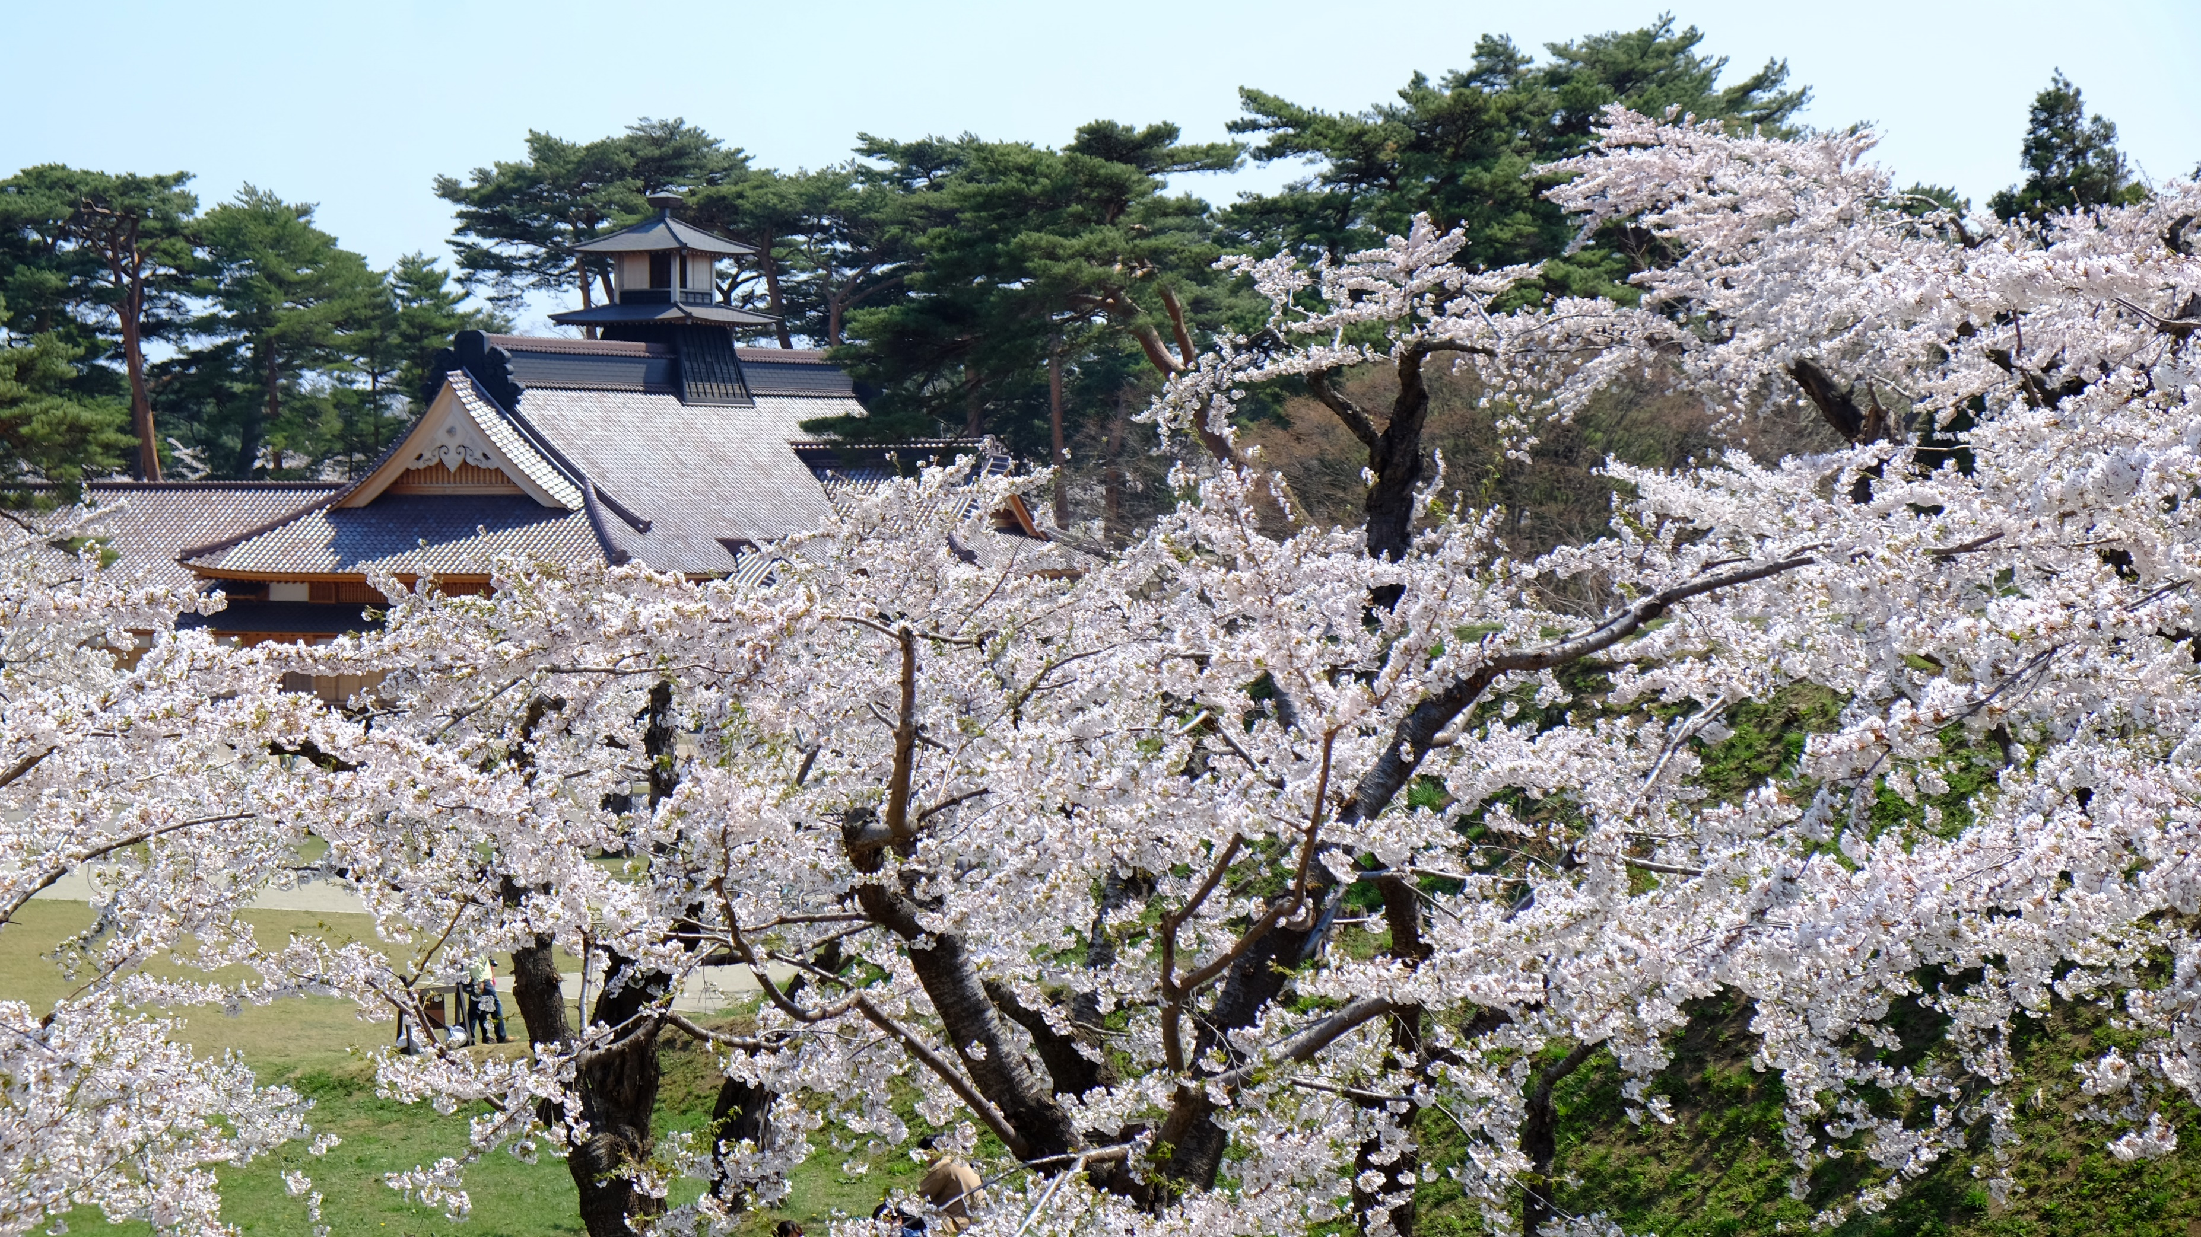

Slide 7
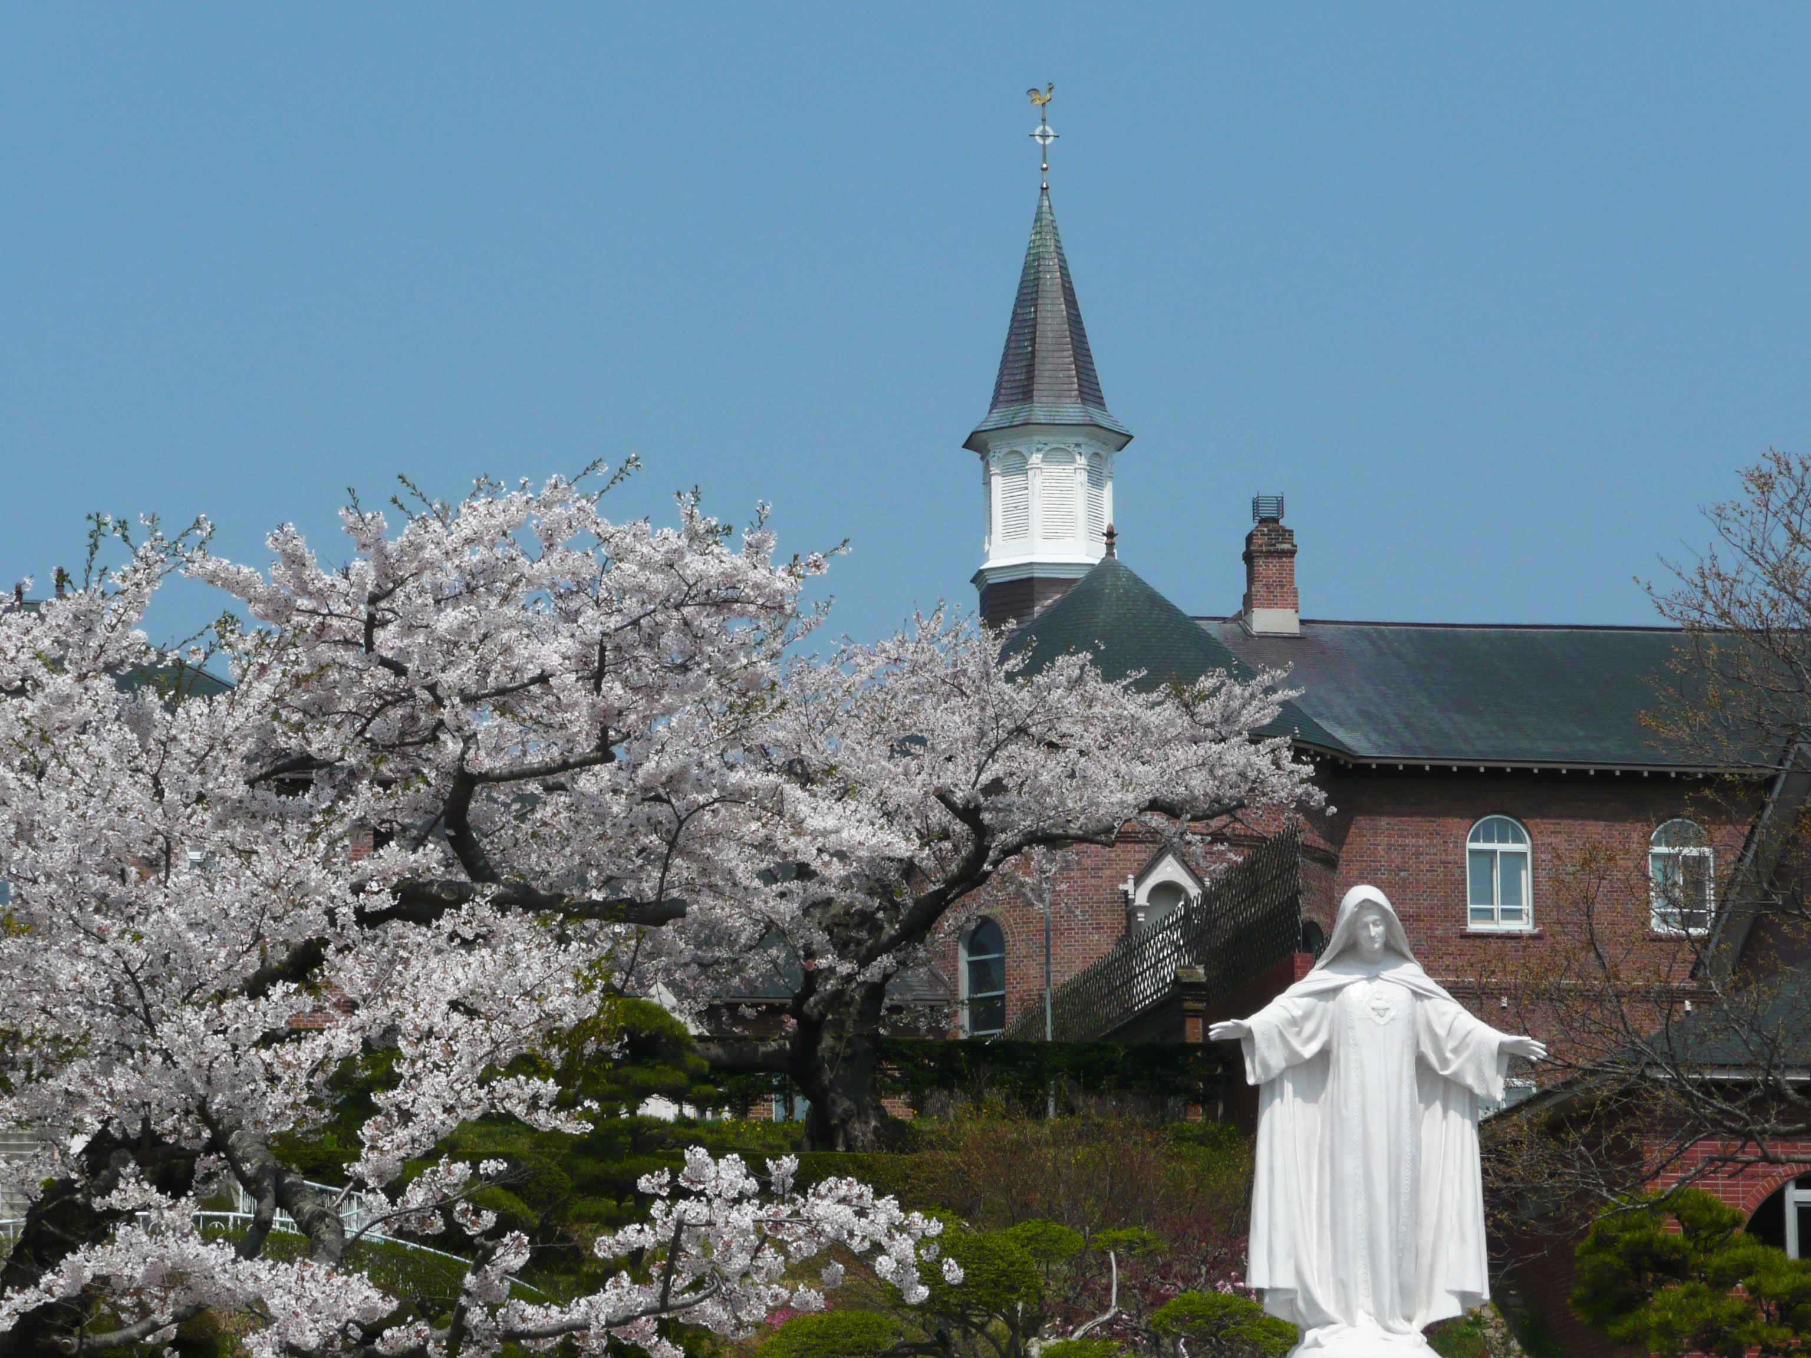
Plan 18 CTS – Noboribetsu – Yakumo – Onuma-koen – Goryokaku – Hakodate – Tobetsu – Matsumae – Mori – Lake Toya – Mt. Usu – Otaru – Sapporo – CTS
Day 5
Sapporo
AM
Shiroi Koibito Park
Hokkaido Jingu Shrine
Maruyama Park
Mt. Moiwa Ropeway
PM
Sapporo TV Tower
Odori Park
Tanuki-koji Shopping Arcade
Day 6
Sapporo – CTS

