Slide 1
Plan 11 NRT – KIX 7 days
NRT – Tokyo – Oshino Hakkai – Matsumoto – Narai-juku –
Okuhida Onsengo – Shirakawago – Takayama – Inuyama – Hikone –
Kyoto - KIX

Slide 2
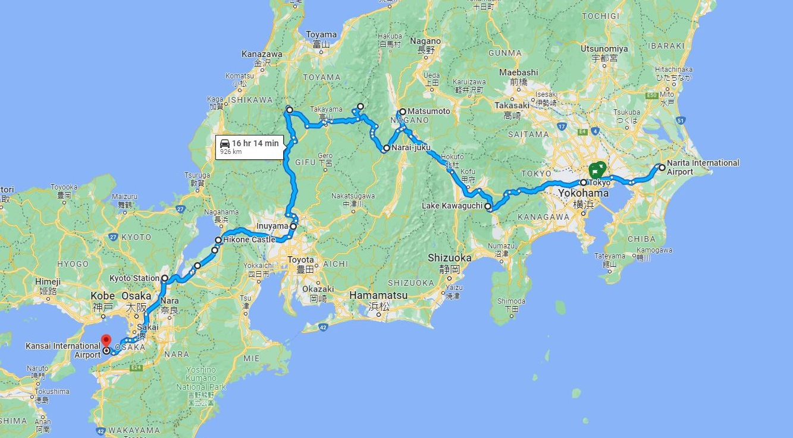

Slide 3
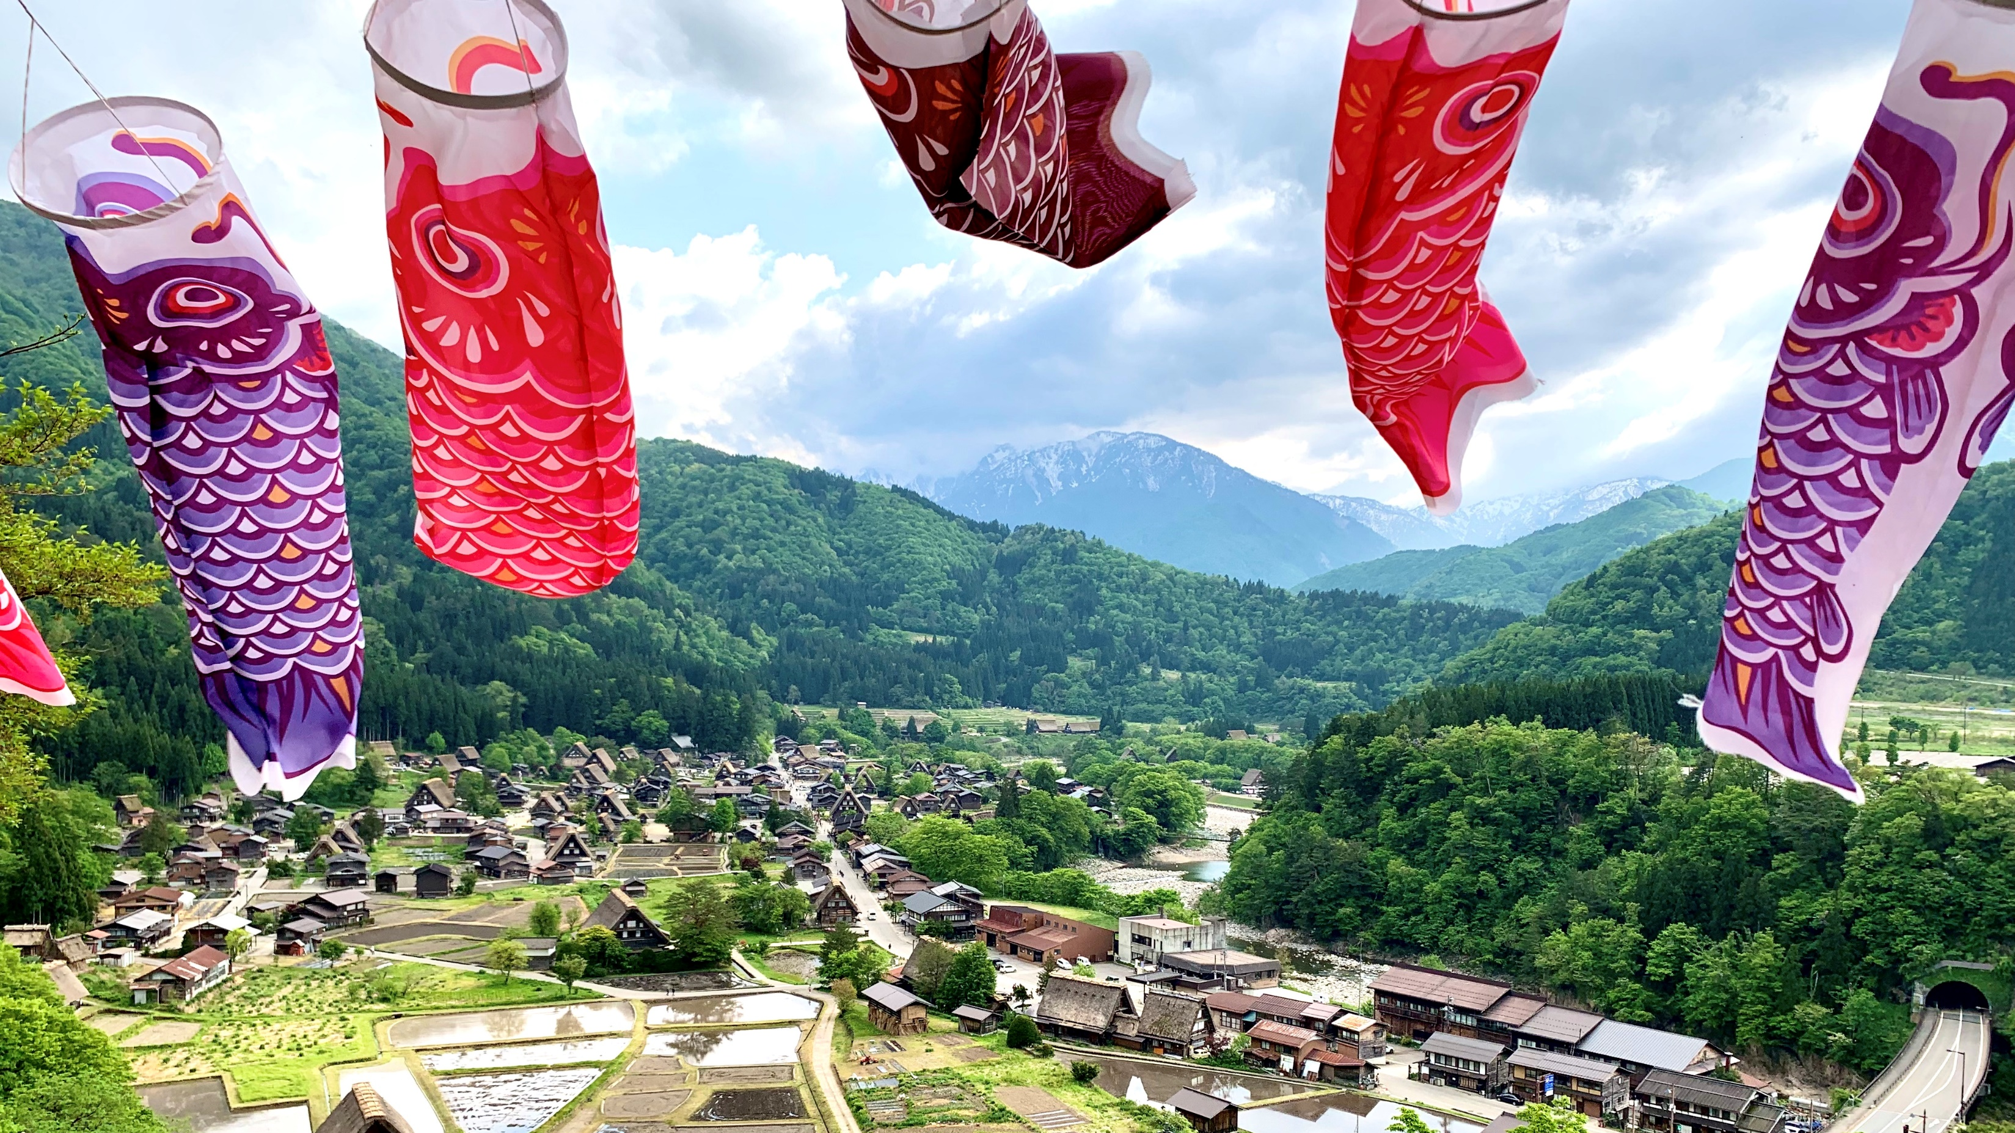

Slide 4
Plan 11 NRT – Tokyo – Oshino Hakkai – Matsumoto – Narai-juku – Okuhida Onsengo – Shirakawago – Takayama – Inuyama – Hikone – Kyoto - KIX
Day 1
NRT - (90 min.) - Tokyo
Day 2
Tokyo
AM
Asakusa Sensoji Temple
Nakamise Shopping Street
Tokyo Skytree
PM
Ueno Ameyoko
Ginza Six Garden
Odaiba
Day 3
Tokyo - (90 min.) - Oshino Hakkai - (50 min.) -
Mt. Fuji 5th Station - (40 min.) - Kawaguchiko Oishi
Park - (120 min.) - Matsumoto
AM
Oshino Hakkai
Mt. Fuji 5th Station
PM
Kawaguchiko Oishi Park
Matsumoto Castle (National Treasure)

Slide 5
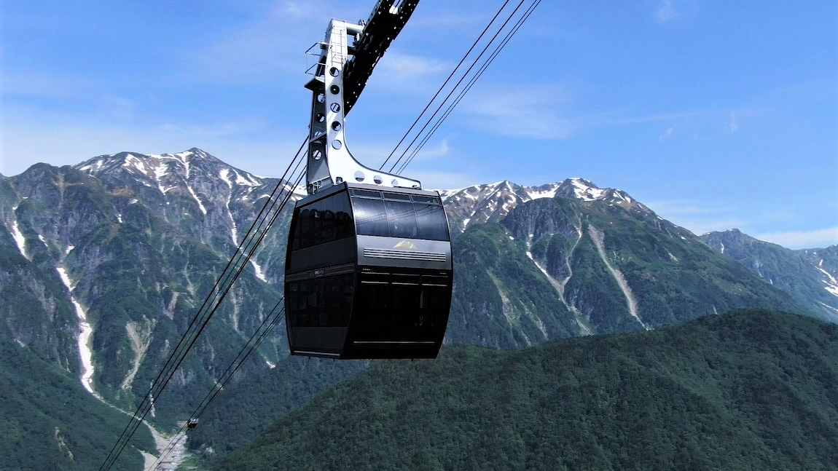

Slide 6
Plan 11 NRT – Tokyo – Oshino Hakkai – Matsumoto – Narai-juku – Okuhida Onsengo – Shirakawago – Takayama – Inuyama – Hikone – Kyoto - KIX
Day 4
Matsumoto - (30 min.) - Daio Wasabi Farm - (60 min.)
- Nakaijuku - (90 min.) - Shin Hotaka Ropeway -
(30 min. ) - Okuhida Bear Park - (10 min.) -
Okuhida Onsengo
AM
Daio Wasabi Farm
Narai-juku
PM
Shin Hotaka Ropeway
Okuhida Bear Park
Okuhida Onsengo
Day 5
Okuhida Onsengo - (90 min.) - Shirakawago -
(50 min.) - Takayama - (120 min.) - Inuyama
AM
Shirakawago
Takayama
Lunch at Takayama
PM
Inuyama Castle (National Treasure)

Slide 7
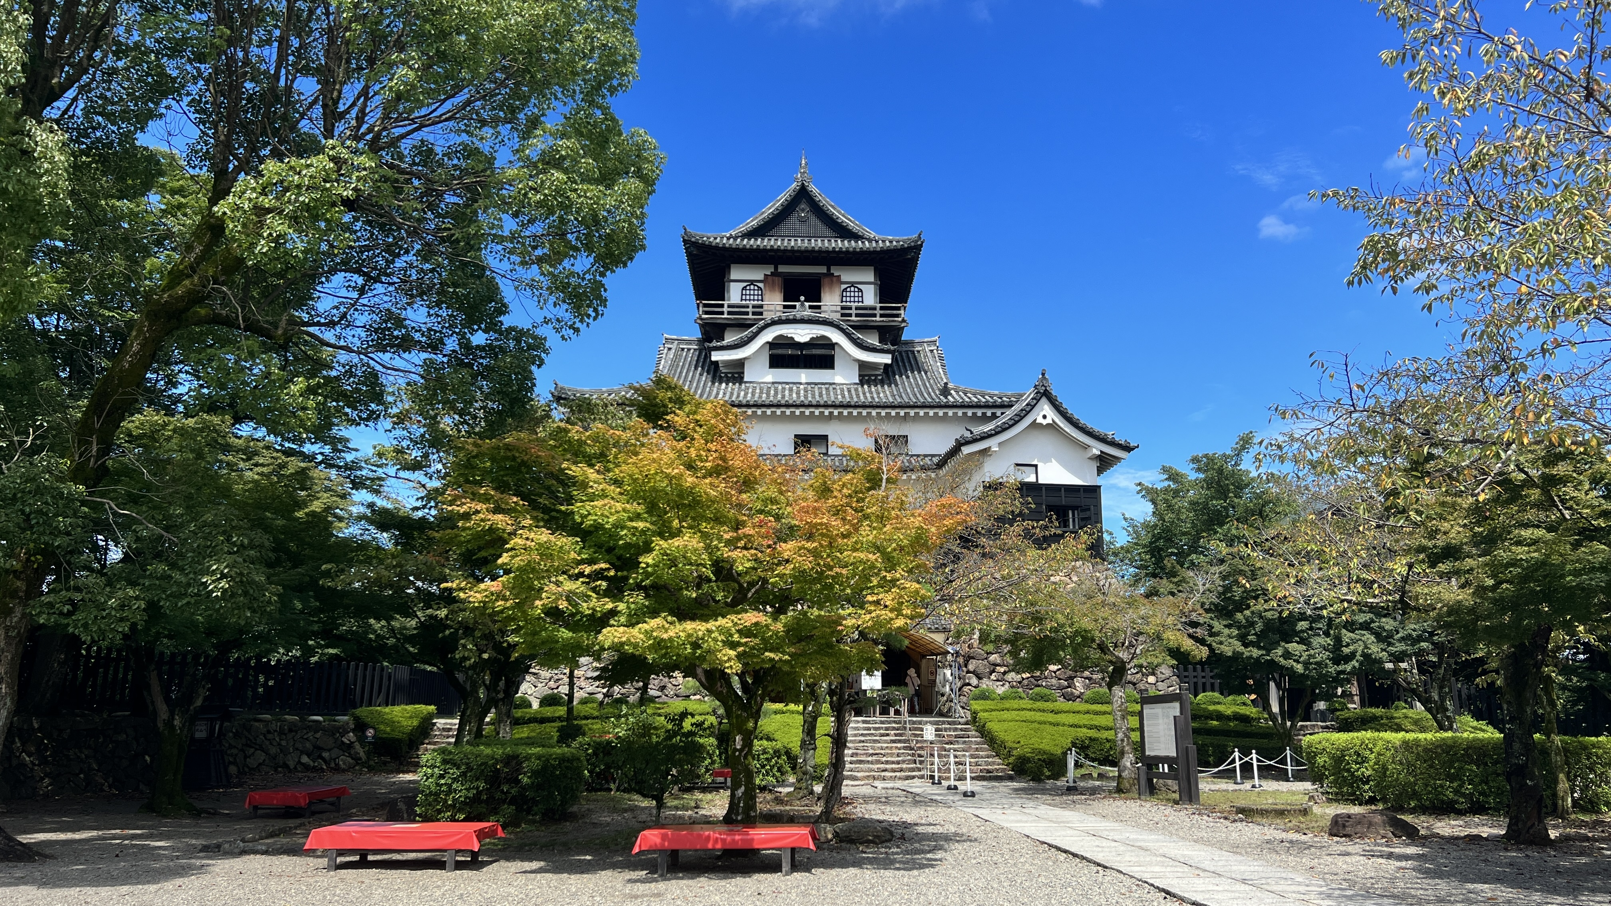

Slide 8
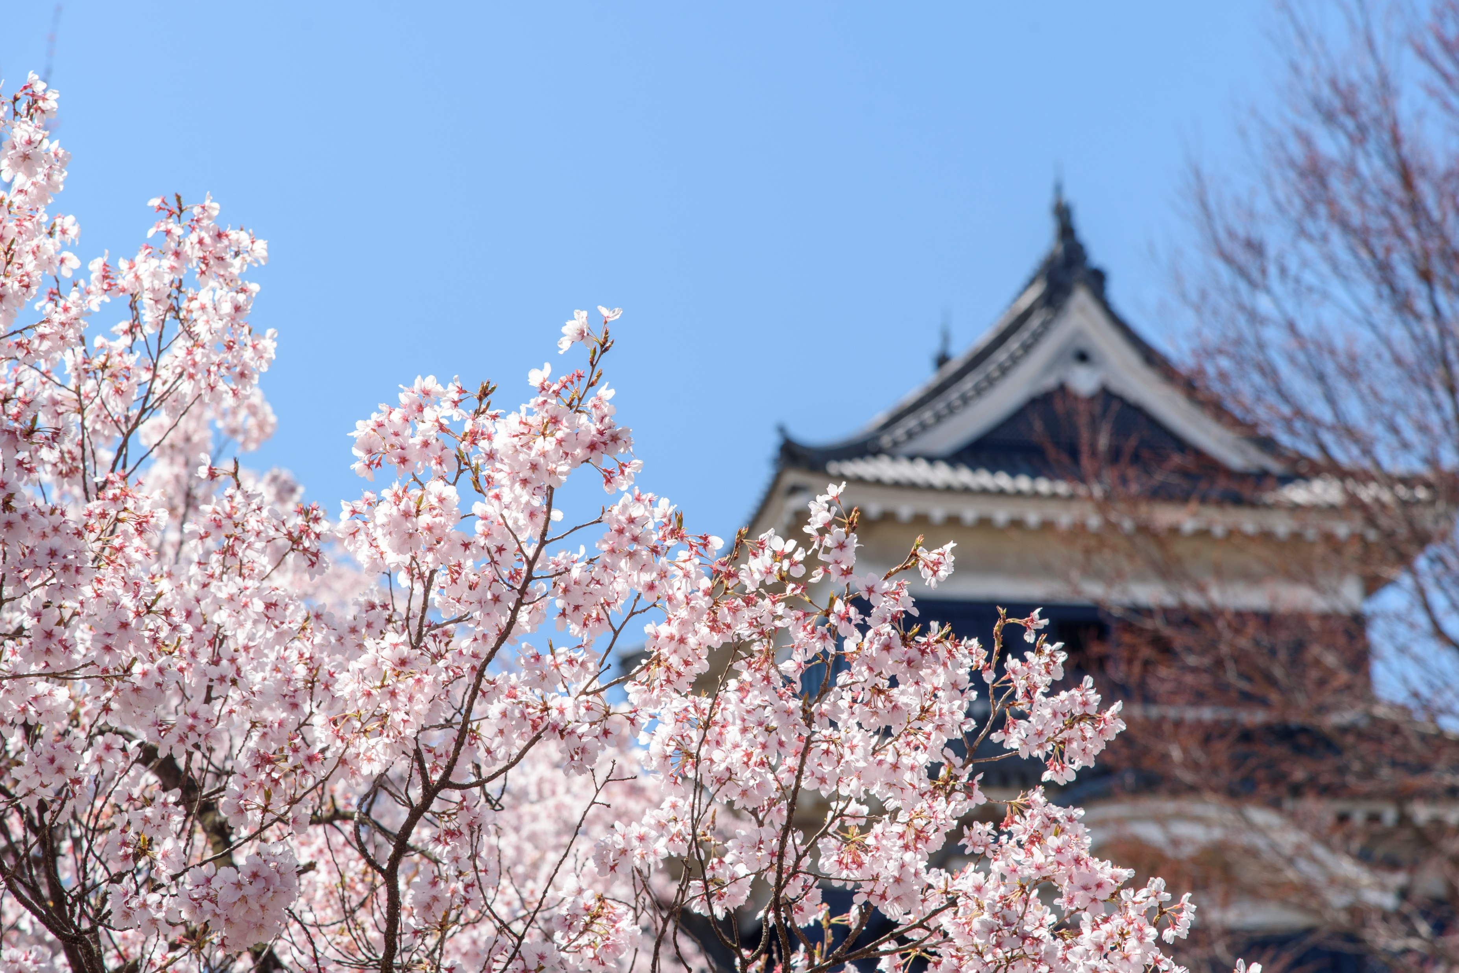
Plan 11 NRT – Tokyo – Oshino Hakkai – Matsumoto – Narai-juku – Okuhida Onsengo – Shirakawago – Takayama – Inuyama – Hikone – Kyoto - KIX
Day 6
Inuyama - (90 min.) - Hikone - (80 min.) - Kyoto
AM
Hikone Castle (National Treasure)
PM
Shogunzuka Seiryuden Obutai in Kyoto
Fushimi Inari Taisha Shrine
Kimono Forest
Day 7
Kyoto - (50 min.) - KIX

