Slide 1
Plan 17 HKD – CTS 6 days ‘Sakura’in Southern Hokkaido
HKD – Hakodate – Matsumae – Goryokaku – Onuma – Shikabe – Mori – Lake Toya – Noboribetsu – Otaru – Sapporo – CTS

Slide 2
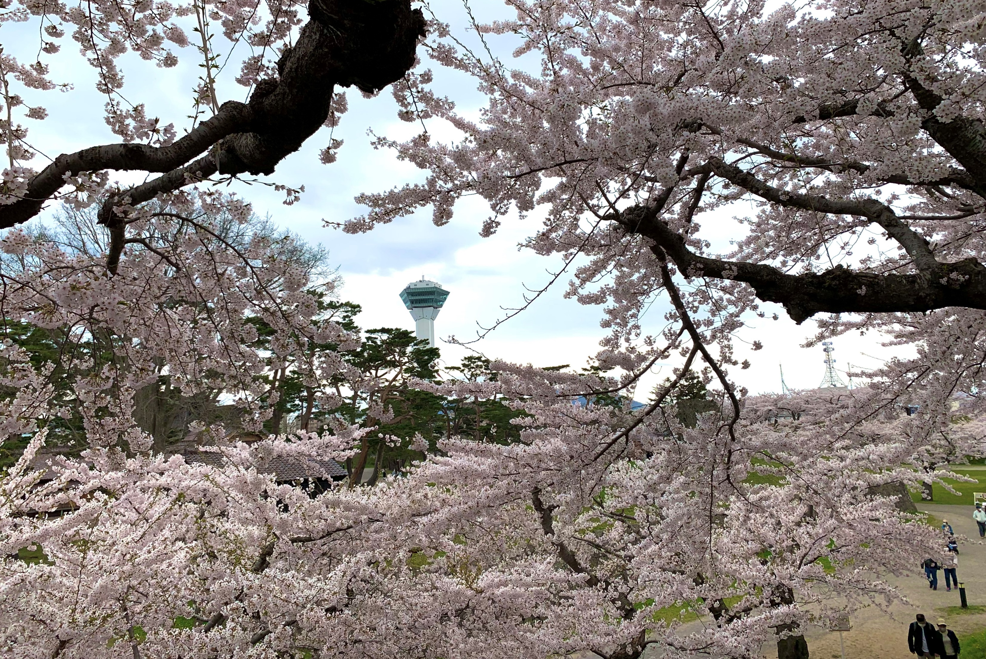
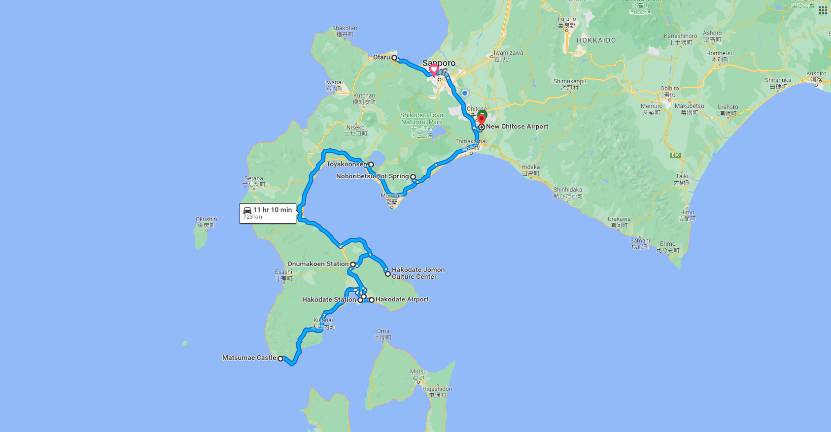
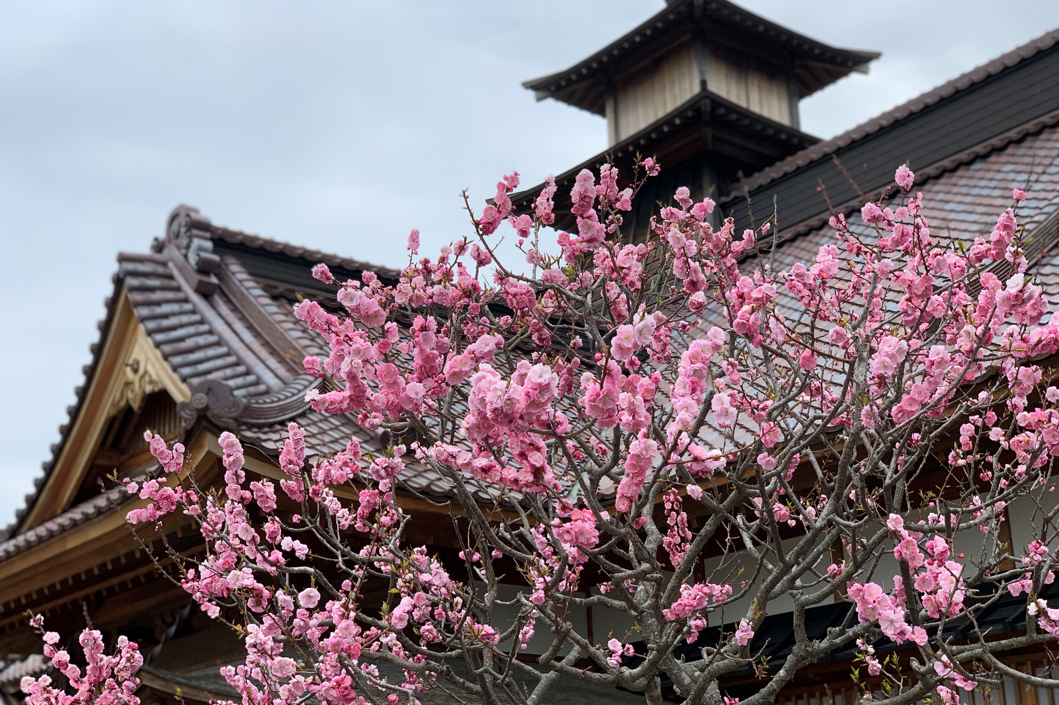
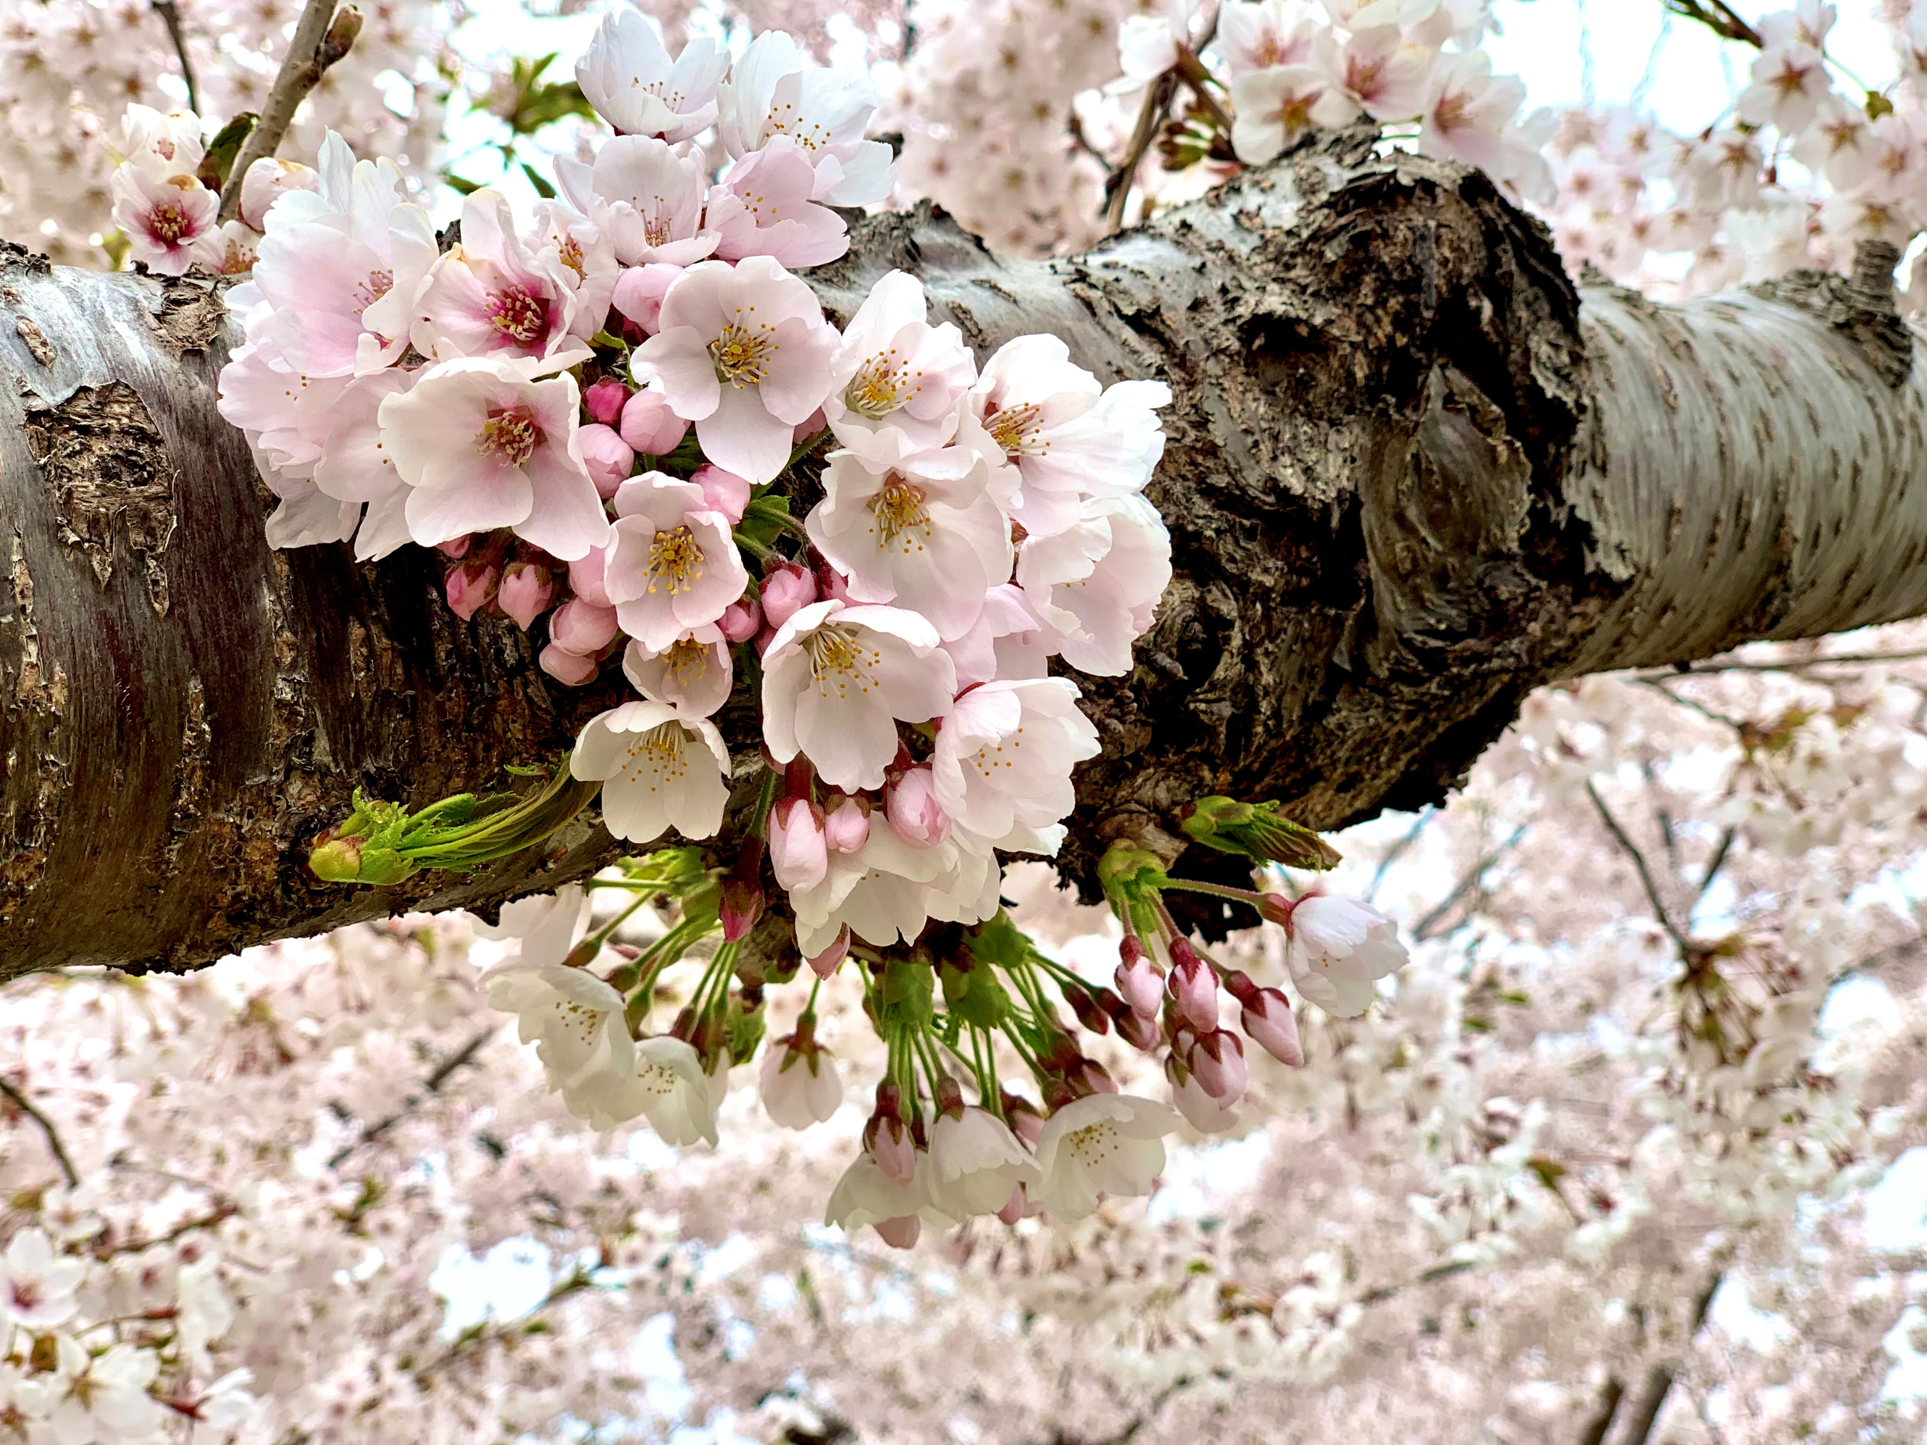
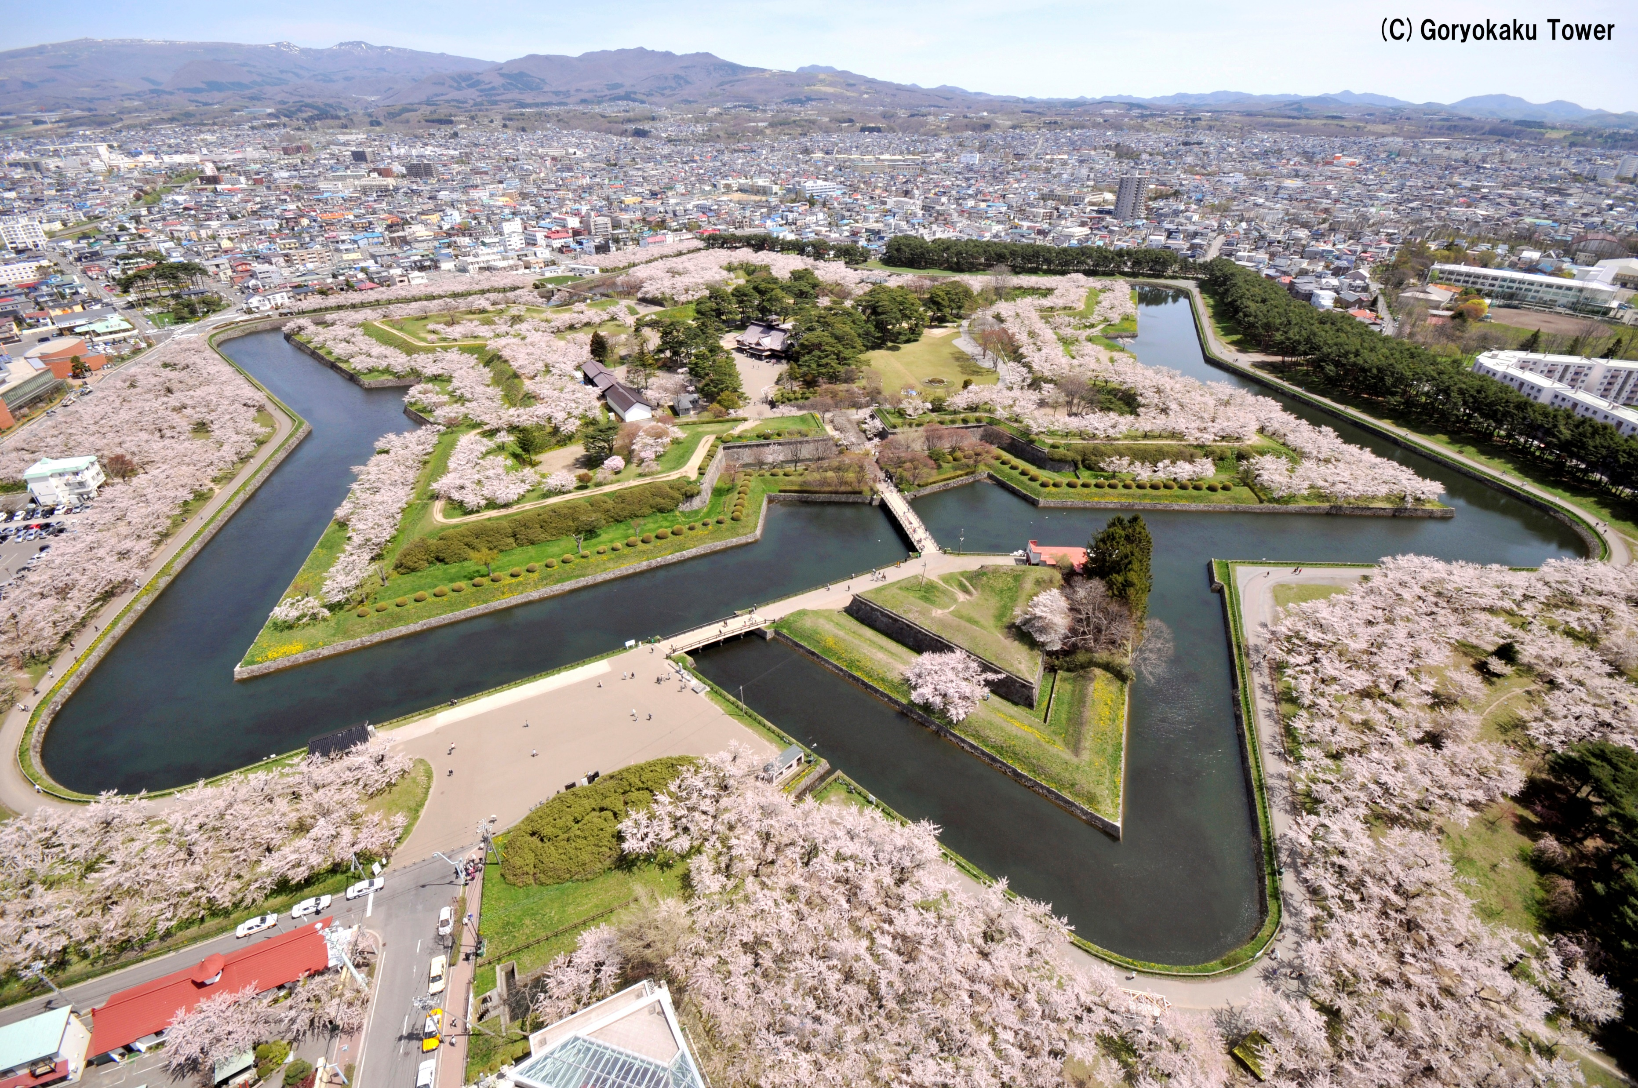

Slide 3
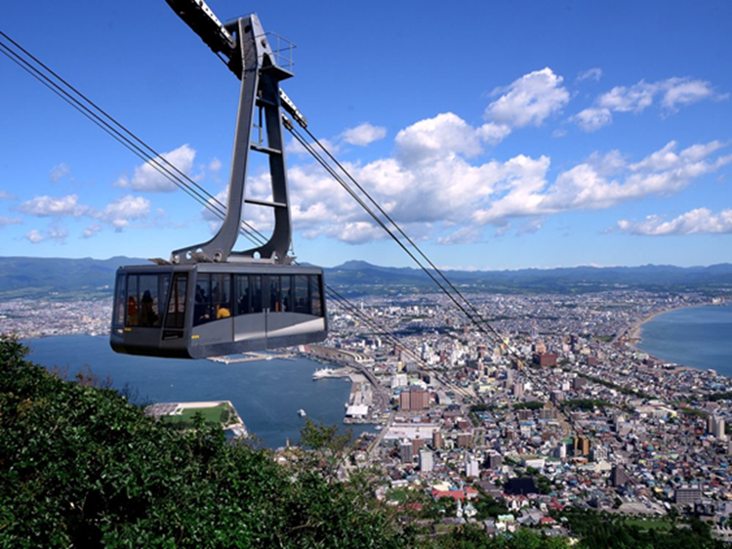
Plan 17 HKD – Hakodate – Matsumae – Goryokaku – Onuma – Shikabe – Mori – Lake Toya – Noboribetsu – Otaru – Sapporo – CTS
Day 1
HKD – (20 min.) – Hakodate
PM
Mt. Hakodate Ropeway
Hakodate Bay Area
Day 2
Hakodate – (120 min.) – Matsumae – (120 min.) –
Goryokaku – (20 min.) – Hakodate
AM
Hakodate Asaichi Morning Market
Cherry Blossoms at Matsumae
PM
Goryokaku Park
Goryokaku Tower

Slide 4
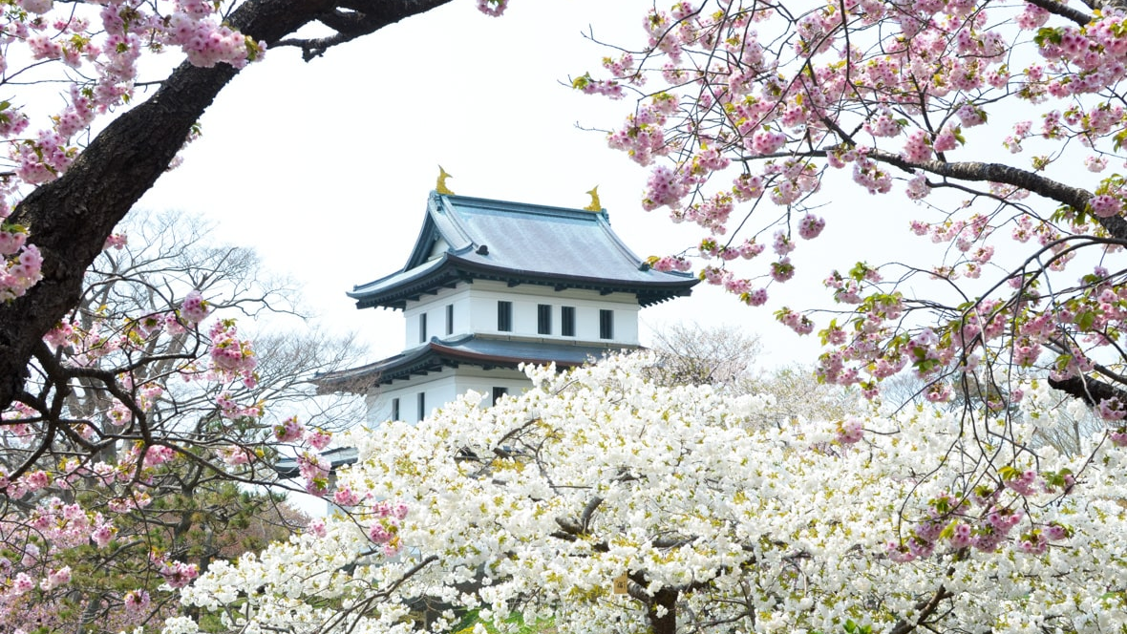

Slide 5
Plan 17 HKD – Hakodate – Matsumae – Goryokaku – Onuma – Shikabe – Mori – Lake Toya – Noboribetsu – Otaru – Sapporo – CTS
Day 3
Hakodate – (30 min.) – Trapistine Convent – (50 min.)
– Onuma – (40 min.) – Shikabe – (60 min.) – Mori –
(40 min.) – Yakumo – (70 min.) – Lake Toya
AM
Trapistine Convent
Onuma-koen Park
Hakodate Jomon Culture Center
PM
Oniushi Park, Mori
Harvester Yakumo, Yakumo Michi-no-eki
Lake Toya
Day 4
Lake Toya – (40 min.) – Noboribetsu – (120 min.) –
Otaru – (60 min.) – Sapporo
AM
Mt. Usu Ropeway
Noboribetsu Bear Park
Noboribetsu Hell Valley
PM
Otaru Canal
Kitaichi Glass Sangokan
Otaru Music Box Museum
Sakaimachi Shopping Street

Slide 6
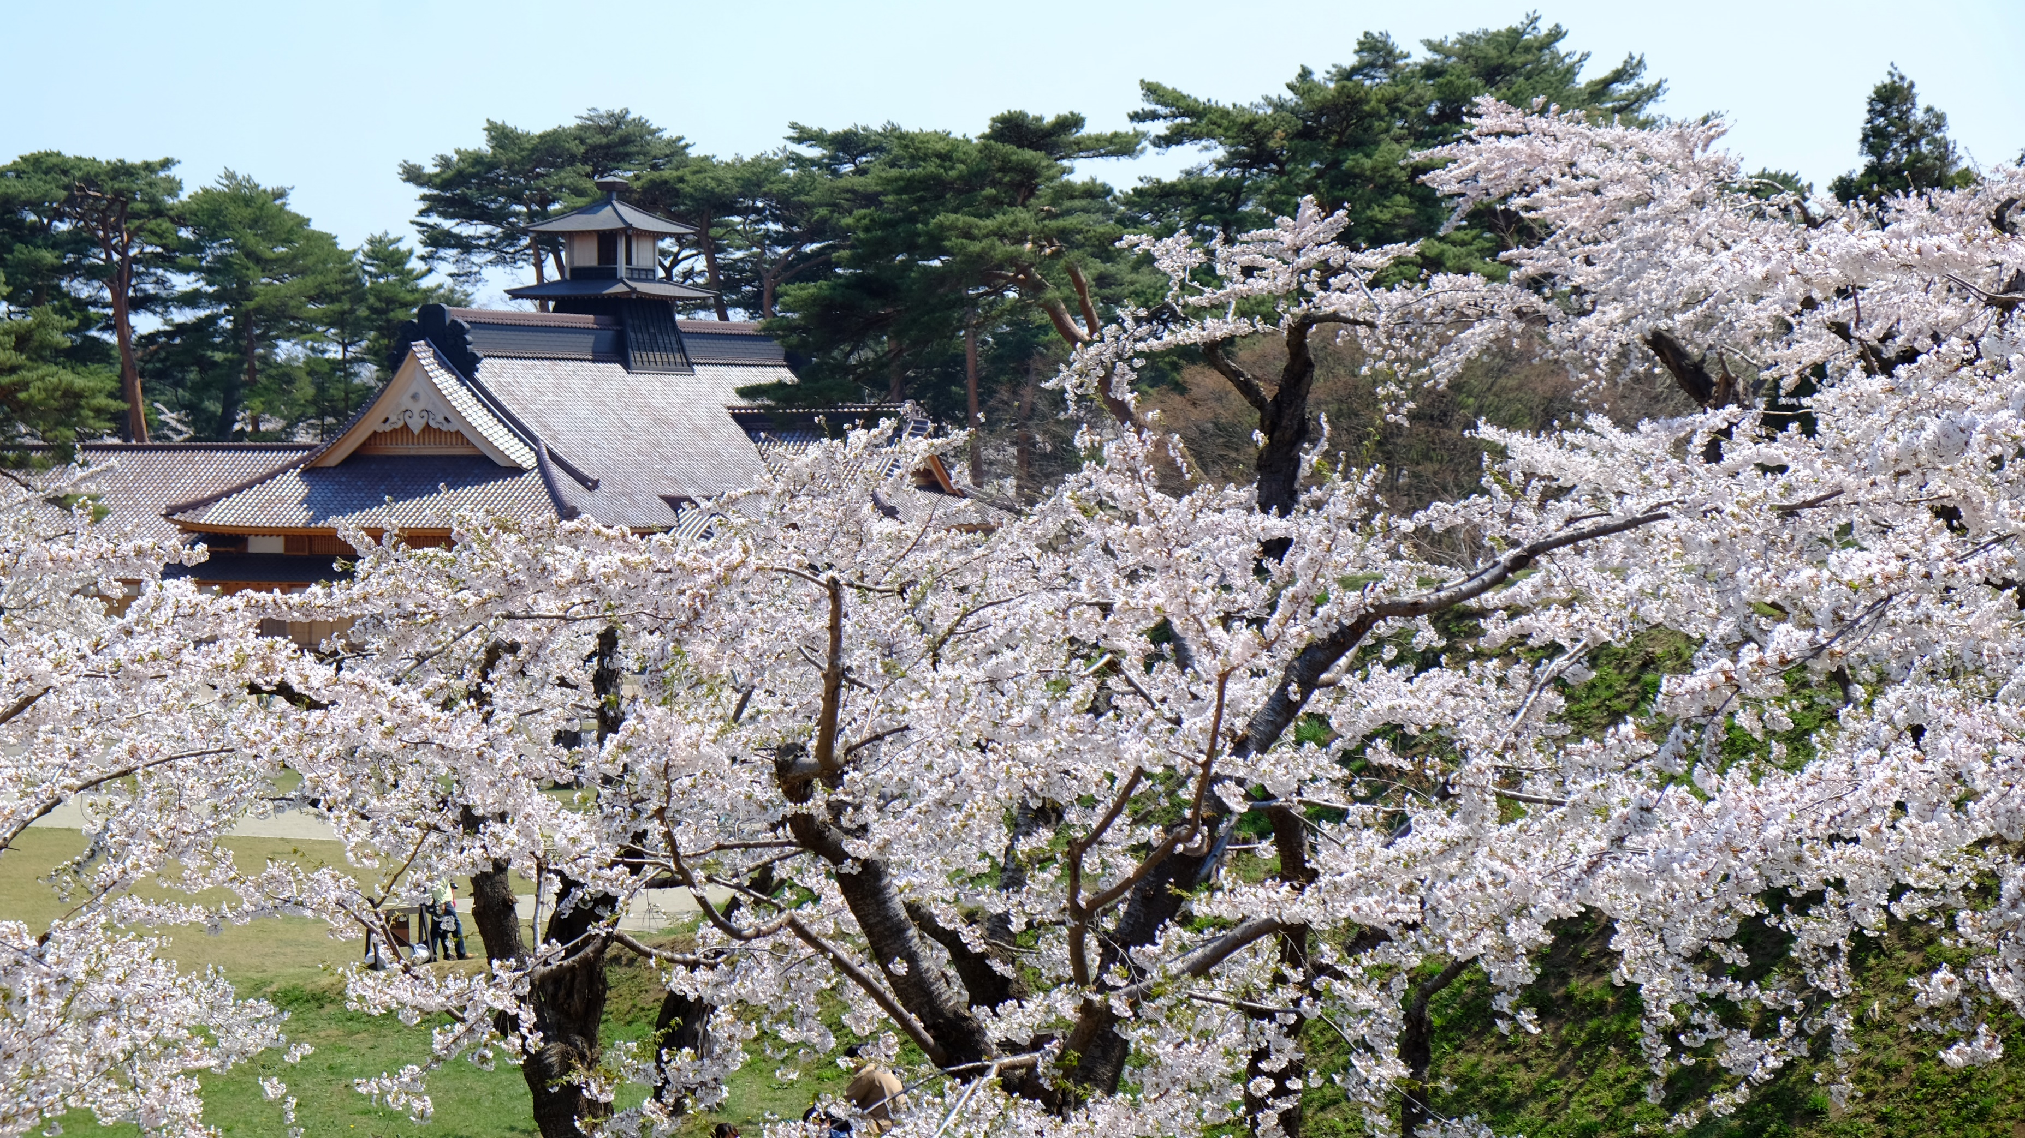

Slide 7
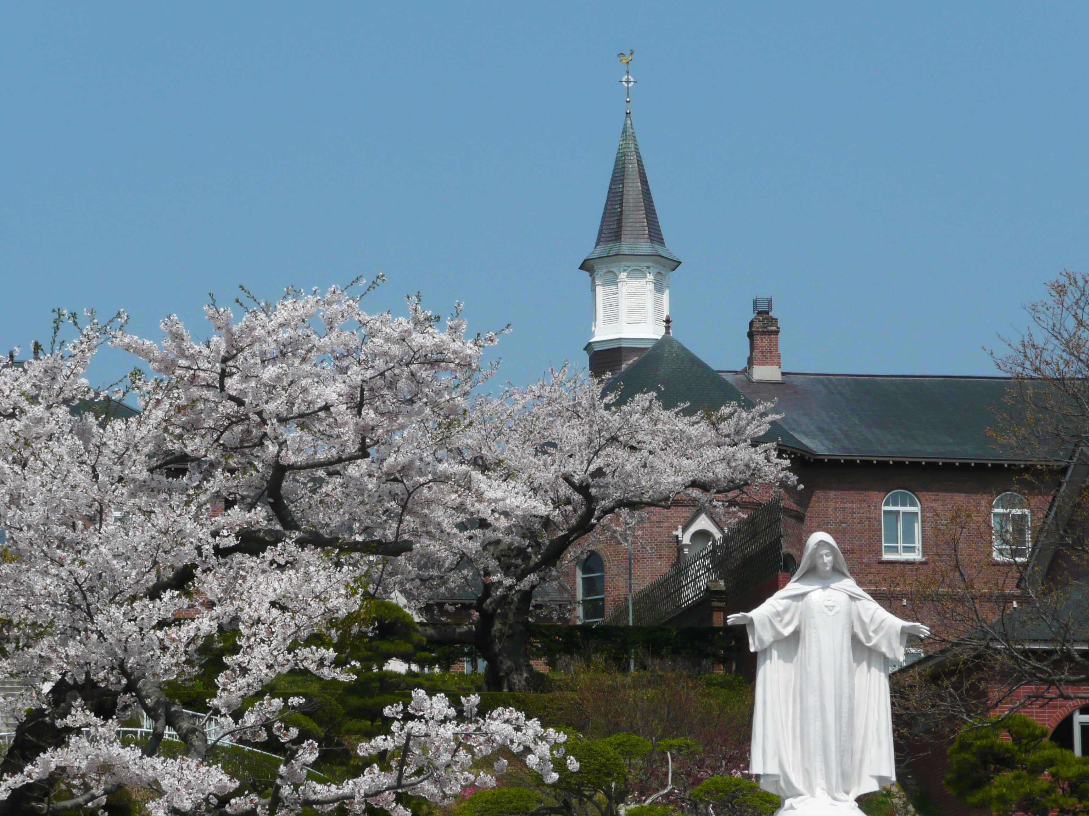
Plan 17 HKD – Hakodate – Matsumae – Goryokaku – Onuma – Shikabe – Mori – Lake Toya – Noboribetsu – Otaru – Sapporo – CTS
Day 5
Sapporo
AM
Shiroi Koibito Park
Hokkaido Jingu Shrine
Maruyama Park
Mt. Moiwa Ropeway
PM
Sapporo TV Tower
Odori Park
Tanuki-koji Shopping Arcade
Day 6
Sapporo – CTS

